Slide 1
Economic crisis and Bankruptcy
Lau Yam Chun

Slide 2
TABLE OF CONTENTS
01
02
03
Objectives
Methodology
Analysis

Slide 3
Objectives
examine the short-term and long-term dynamics between economic crisis and bankruptcy through the implementation of a VAR model
identify the key economic indicators and variables that influence bankruptcy during periods of economic crisis
To assess the sensitivity of bankruptcy rates to changes in economic conditions and identify potential early warning indicators for increased bankruptcy risk

Slide 4
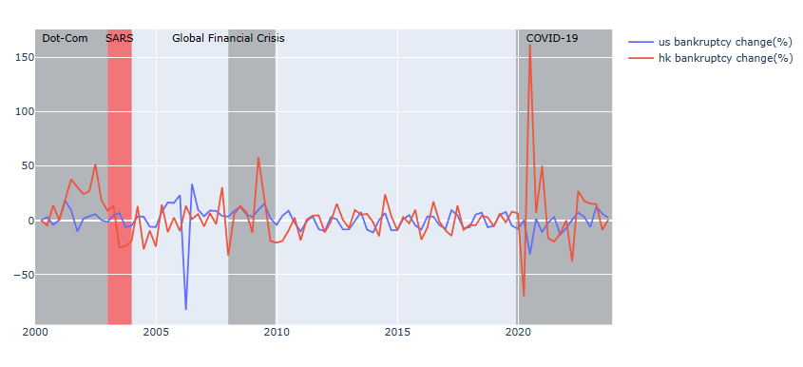
Comparison of percentage change

Slide 5
UNDERSTANDING THE PROBLEM
Economic Environment
Policies
It would affect Revenue, credit conditions, market conditions, consumer spending patterns……
Bankruptcy laws and regulations, fiscal policies, economic stabilization meansures, support scheme……

Slide 6
Vector Autoregression model
Data Collection
Identify Variables
Data Preprocessing
Lag Order Selection
Diagnostics

Slide 7
Identify Variables : Cointegration Test
Name | Test Stat > C(95%) | Significance
U.S bankruptcy | 578.64 > 219.4 | True
Federal Funds Effective Rate | 442.58 > 179.5199 | True
U.S unemployment rate | 235 > 111 | True
U.S employment cost index | 320 > 143 | True
Interest rates: 10 years bonds yields | 164 > 84 | True
NASDAQ Composite Index | 66.17 > 40.1749 | True
NYSE Composite Index | 35.23 > 24.27 | True
GDP change | 6.85 > 4.12 | True
HK bankruptcy | 18 > 16 | True

Slide 8




Data Collection
Quarterly data from period 2000 to 2022

Slide 9
Data Preprocessing: Stationarity Checking Method : Augmented Dickey-Filler Test
Name | P Value | Stationarity
U.S bankruptcy | 0.0331 < 0.05 | True
Federal Funds Effective Rate | 0.002 < 0.05 | True
U.S unemployment rate | 0.998 > 0.05 | False
U.S employment cost index | 0.1039 > 0.05 | False
Interest rates: 10 years bonds yields | 0.2099 > 0.05 | False
NASDAQ Composite Index | 0.9129 > 0.05 | False
NYSE Composite Index | 0.393 > 0.05 | False
GDP change | 0.0 < 0.05 | True
HK bankruptcy | 0.0058 < 0.05 | True

Slide 10
Lag Order Selection
Order | AIC | BIC | FPE | HQIC
0 | 203.2 | 203.5* | 1.7e+88 | 203
1 | 200.1 | 203.6 | 8.512e+86 | 201*
2 | 200.2 | 206.8 | 1.015e+87 | 202
3 | 198.9 | 208.8 | 4.56e+86 | 202
4* | 196.4* | 209.4 | 9.7e+85* | 201

Slide 11
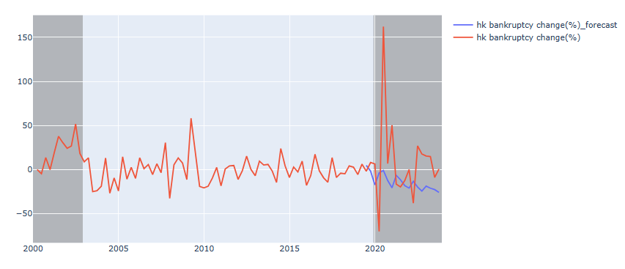
Results
It predicts the trend,
but overestimate
the result
Metrics Score
mape : 5.15
me : -14
mae : 28.7
mpe : -5.12
rmse : 46.57
corr : 0.21
minmax : 2.22

Slide 12
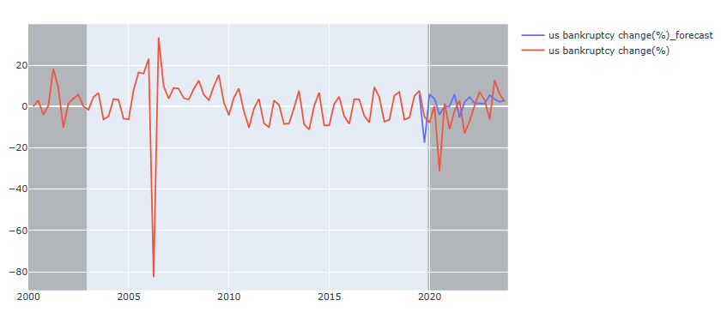
Results
It predicts the trend,
but overestimate
the result
Metrics Score
mape : 11.8128
me : -22.9313
mae : 24.0319
mpe : -9.9124
rmse : 28.7352
corr : -0.3714
minmax : 9.8555

Slide 13
ANALYSIS
The measures taken by the government after the economic crisis occurs and political changes will affect the probability of corporate bankruptcy

Slide 14
U.S Crisis and Policies
Crisis | Policies | Score
Dot-Com Bubble(2000-2002) | Federal Reserve Intervention: 7 Tax Cuts: 6 Increased R&D Funding: 7 Regulatory Reforms: 6 Job Training and Retraining Programs: 7 | 33
Global Financial Crisis(2008-2009) | Troubled Asset Relief Program (TARP): 8 American Recovery and Reinvestment Act (ARRA): 9 Federal Reserve Intervention: 9 Automotive Industry Bailout: 7 Housing Market Support: 8 | 41
Pandemic(2019-2023) | Paycheck Protection Program (PPP): 8 Economic Injury Disaster Loan (EIDL) Program: 7 Employee Retention Tax Credit (ERTC): 6 Pandemic Unemployment Assistance (PUA): 7 Industry-Specific Support: 7 | 35
Note: each policy would rate from 1 to 10, more policies adopted by gov, the higher the score it is

Slide 15
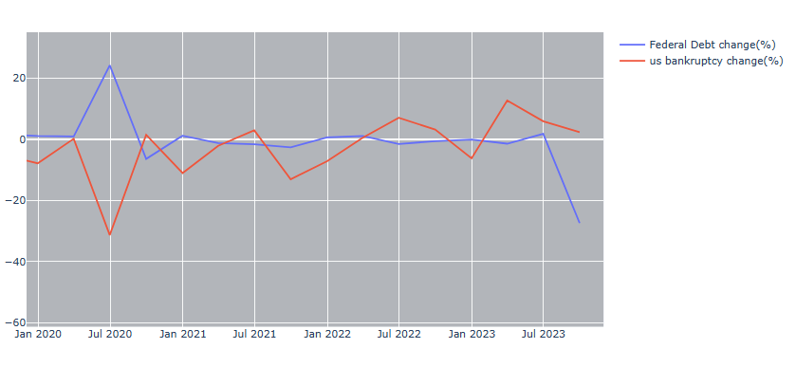
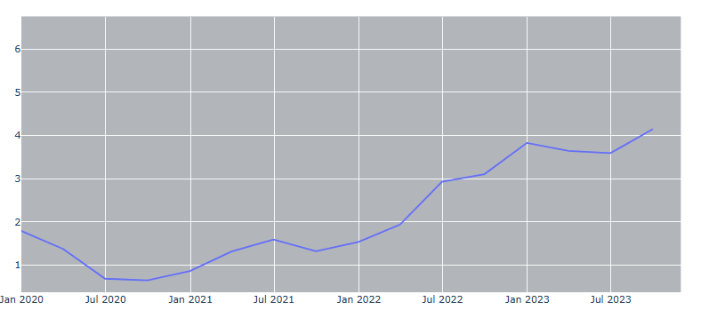
How U.S help the market during covid?
Federal debt to GDP proportion change
Interest rate

Slide 16
HK Crisis and Policies
Crisis | Policies | Score
SARS Outbreak(2003) | Financial Assistance: 3 Tax Relief Measures: 6 Rent and Utility Support: 6 | 15
Global Financial Crisis(2008-2009) | Provision of Liquidity injections and support banks: 8 Economic Stimulus Packages: 7 Employment Support: 9 SME (helped mitigate the impact of the crisis on small firm): 7 Housing Market Support: 6 Promotion of External Trade and Investment: 8 | 45
COVID-19(2019-2023) | Financial Assistance: 8 Loan and Financing Support: 7 Employment Support: 9 Business Adaptation and Digital Transformation: 8 Rent Relief: 6 Regulatory Flexibility: 7 | 45

Slide 17
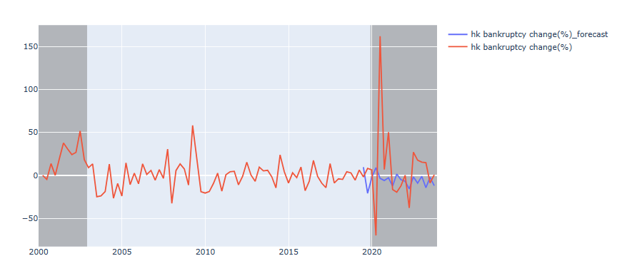
Results after adding policies scores
Metrics Score
mape : 5.4888
me : -13.277
mae : 30.98
mpe : -5.4888
rmse : 48.09
corr : -0.064
minmax : 5.8834

Slide 18
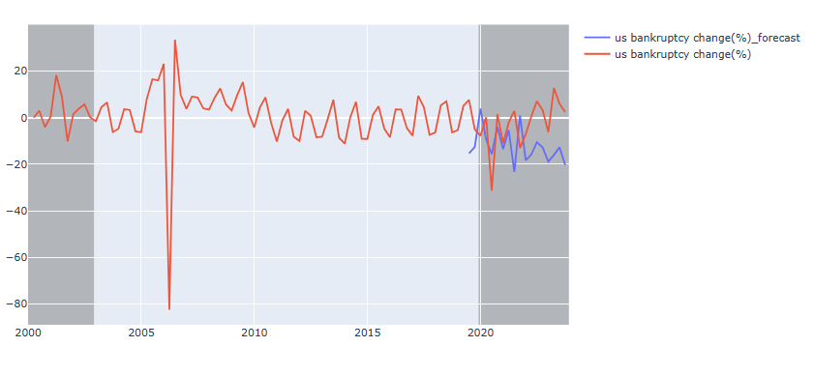
Results after adding policies scores
Metrics Score
mape : 6.903 (improved)
me : -10.0026 (improved)
mae : 14.597 (improved)
mpe : -6.1381 (improved)
rmse : 16.3291 (improved)
corr : -0.1708 (improved)
minmax : 6.8687 (improved)

Slide 19
Limitations of model and data
- Political changes:
It is hard to include in the data. E.g. president selections, economic structure
- Domain knowledge:
Maybe other business factors would affect the result
- Data Frequency:
Only quarterly and annually data from 2000 to 2023 are available
- Data Availability:
Limited data and indicators are free from the markets, likely lead to omitted variable bias

Slide 20
Possible Improvement
- Create an index for political changes
- Include Hong Kong GDP
- Include Hong Kong housing index, HK and US net flows of foreign direct investment - - Include European economic Indicator
- Include US dollars Index

Slide 21
Thank you

